Slide 1
Introduction to Computer Graphics
Course Overview
课程概述

Slide 2
Overview (课程概述）
Theory + Technology
  Introduce the basic knowledge about computer graphics (理论)
  Including teaching the OpenGL (a tool to write your 3D programs) （技术）

Slide 3
Overview (课程概述）
学分（ 3+1 ）
  理论
    时间：每周周四9、10、11节
  实验
    时间：每双周四7、8节
  Requiring hard work (about 2h/w to learn, 3h/w to practice) 建议每周用时 2小时学习，3小时训练编码

Slide 4
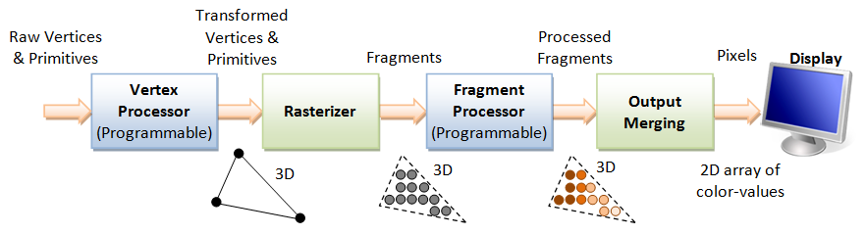
Objectives （课程具体目标）
Broad introduction to Computer Graphics
  The generation procedure of a image using a computer (用计算机生成一张图片的过程）
  Introduce the details of the key stages of the rendering pipeline
  Introduce the details of how to represent or organize a scene

Slide 5
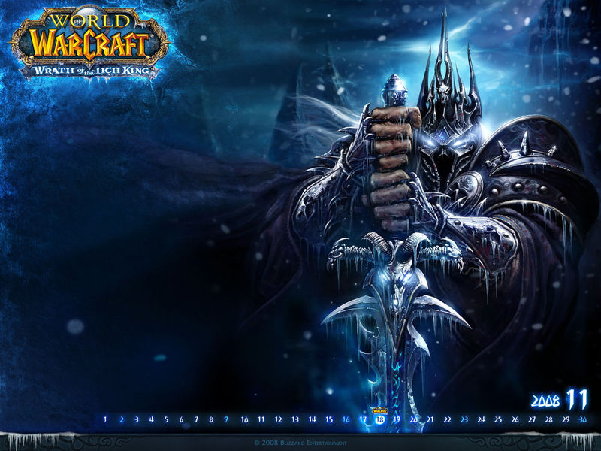
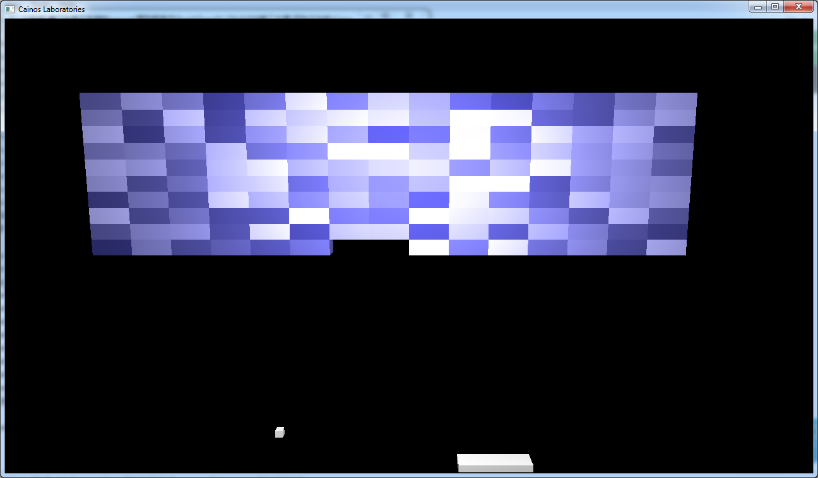
Objectives （课程具体目标）
OpenGL based course
  to write a 3D program (怎样写一个3D程序）

Slide 6

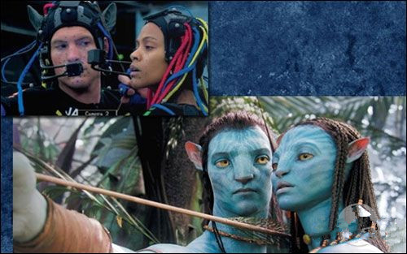
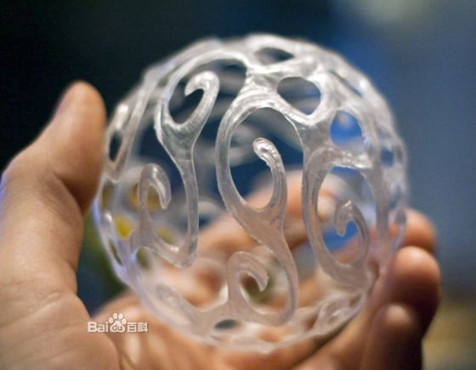
Objectives （课程具体目标）
Introduce the latest techniques on computer graphics
  3D Printing
  Virtual Reality Glass
  3D Movies
  …
  AIGC

Slide 7

Prerequisites (先修条件）
Good programming skills in C (or C++)
  热爱编程，编程基础扎实
Basic Data Structures （数据结构基础）
  Linked lists
  Arrays

Slide 8
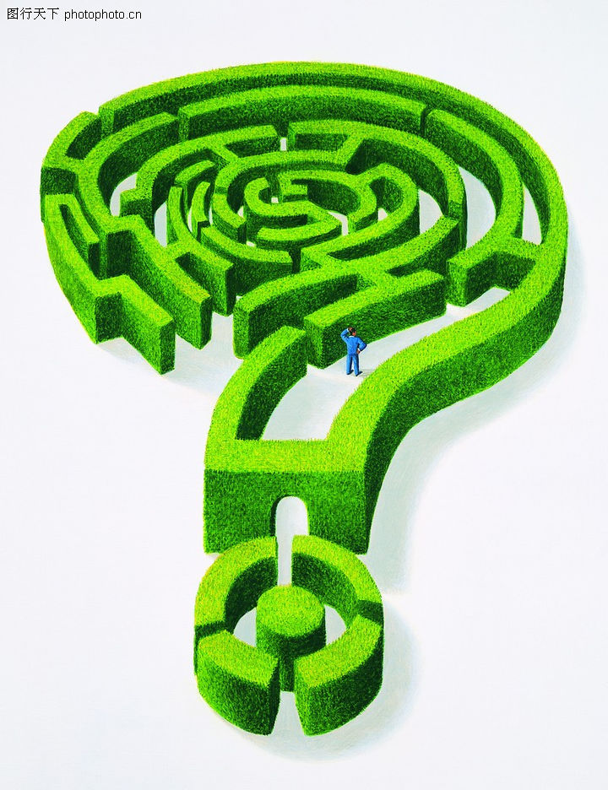
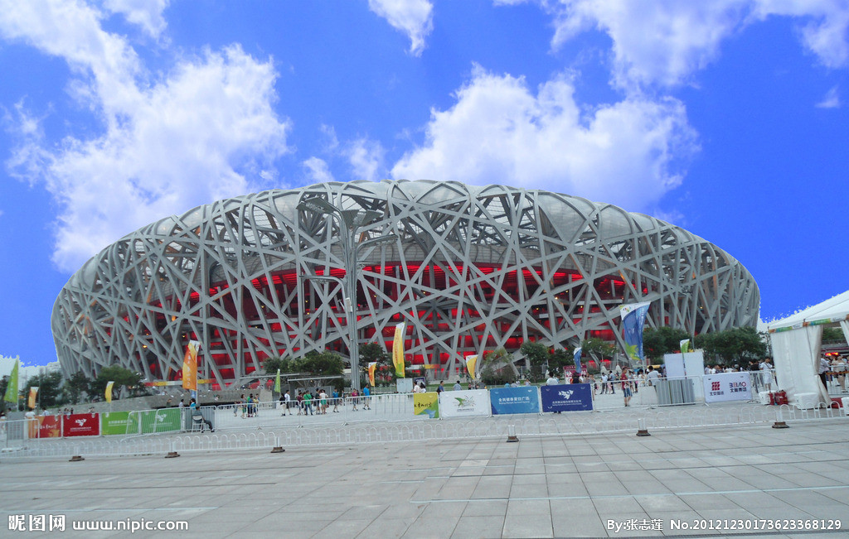
Prerequisites (先修条件）
Geometry （空间几何的直觉）

Slide 9
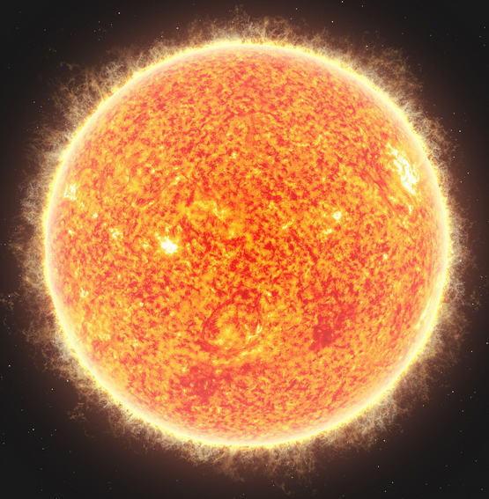
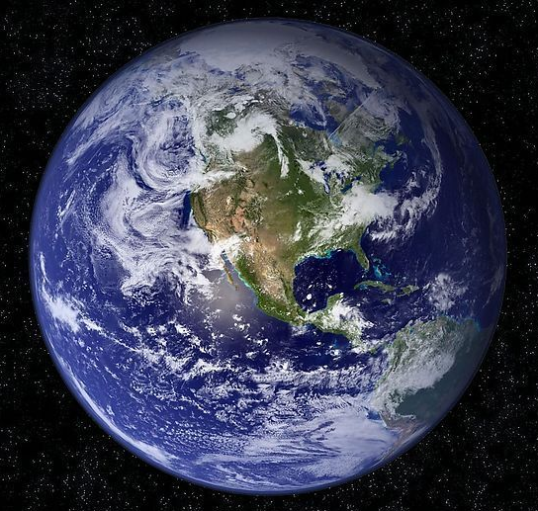

Prerequisites (先修条件）
Solid Linear Algebra （扎实的线代功底）
$$M=[\begin{matrix}? & ? & ? \\ ? & ? & ? \\ ? & ? & ?\end{matrix}]$$

Slide 10
Grading policy (评分标准)
4~6 Experiments 55%
  Interactive
  3D
Exam: 40%
Attendance 出勤 5%

Slide 11
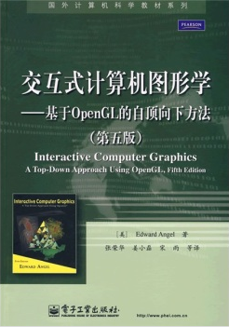
Textbook(教材）
Interactive Computer Graphics - A Top-Down Approach 5th Edition （主教材）
  中文版《交互式计算机图形学-基于OpenGL的自顶向下方法》第5版

Slide 12
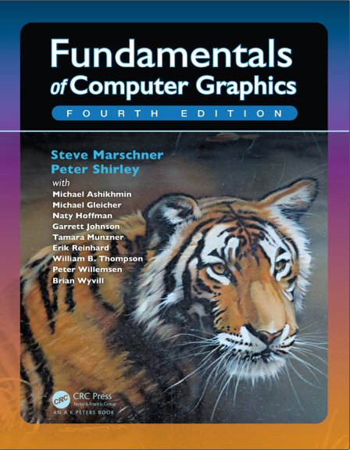
Textbook(教材）
Fundamentals of Computer Graphics
4th Edition （辅助材料）（The Tiger Book）
  计算机图形学基础（第四版）

Slide 13
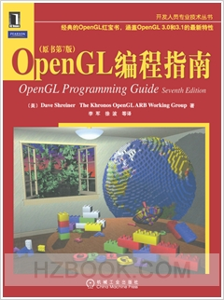
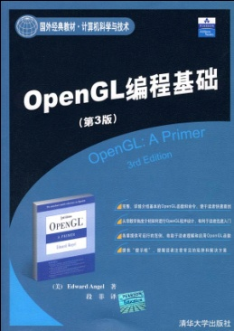
References (参考资料）
The OpenGL Programmer’s Guide (the Redbook) 7th Edition
  OpenGL编程指南 第七版 （俗称红宝书）
OpenGL A Primer 3rd Edition
  OpenGL编程基础 第三版

Slide 14
Resources
Teaching Ftp
  ftp://121.192.180.236，端口21
QQ Group
  924058445

Slide 15
Outline: Part 1
Part 1: Introduction
Contents
  What is Computer Graphics?
  Applications Areas
  History
  Image formation
  Basic Architecture

Slide 16
Outline: Part 2
Part 2: Basic OpenGL
Contents
  Architecture
  GLUT
  Simple programs in two and three dimensions
  Interaction

Slide 17
Outline: Part 3
Part 3: Three-Dimensional Graphics
Contents
  Geometry
  Transformations
  Homogeneous Coordinates
  Viewing
  Lighting and Shading

Slide 18
Outline: Part 4
Part 4: Implementation
Contents
  Approaches (object vs image space)
  Implementing the pipeline
  Clipping
  Line drawing
  Polygon Fill
  Display issues (color)
  Implementing a basic raytracer

Slide 19
Outline: Part 5
Part 5: Geometry and Other Graphics Technologies
  Bezier Curve
  Point Cloud
  Mesh
  Animation
  …

